Slide 1
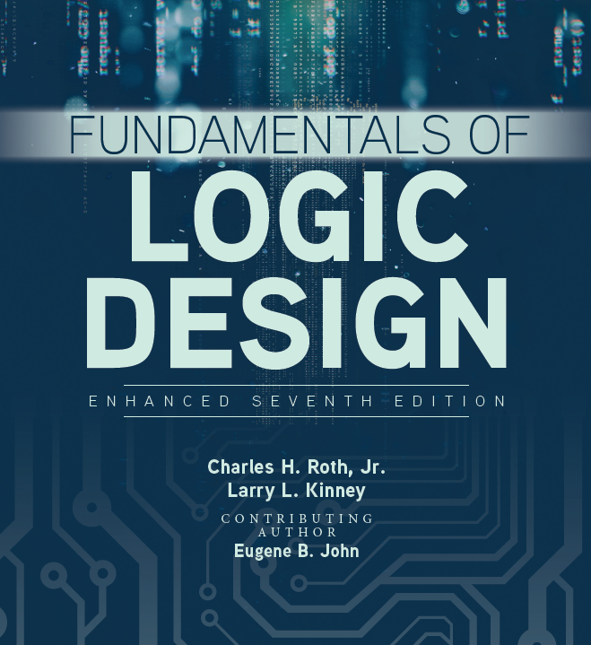


Unit 4
Applications of Boolean Algebra
Minterm and Maxterm Expansions

Slide 2
This chapter includes:
4.1 Conversion of English Sentences to Boolean Equations
4.2 Combinational Logic Design
Using a Truth Table
4.3 Minterm and Maxterm Expansions
4.4 General Minterm and Maxterm Expansions
4.5 Incompletely Specified Functions
4.6 Examples of Truth Table Construction
4.7 Design of Binary Adders and Subtracters

Slide 3
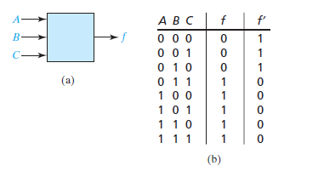

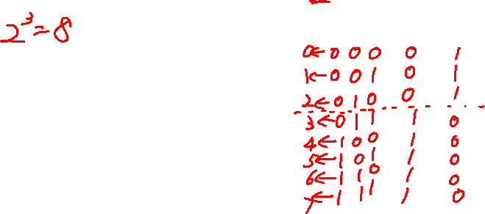
Combinational Logic Design Using a Truth Table
Logic Design with Truth Tables:
Take a three-input, one output system where A,B,C are inputs that represent the digits of binary number N and f is the output such that f=1 if N>=3 and f=0 if N<3.

Slide 4
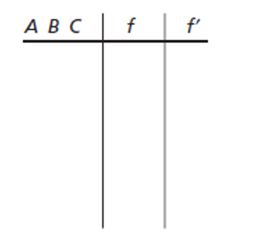
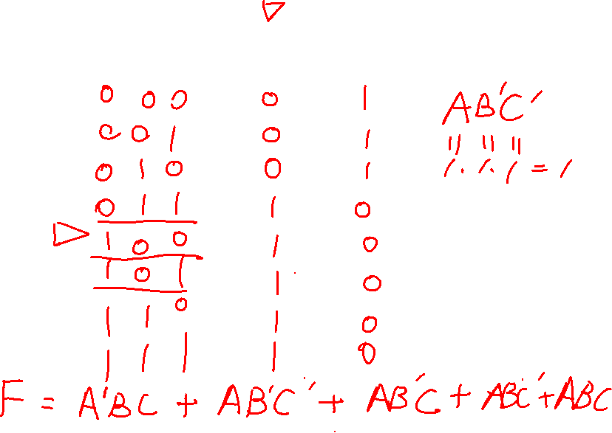

Slide 5
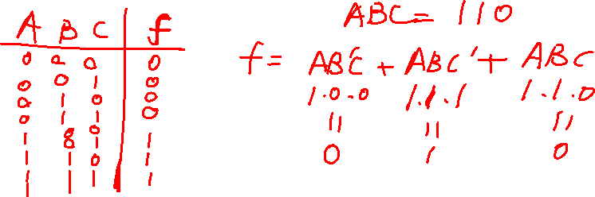
Combinational Logic Design Using a Truth Table
Logic Design with Truth Tables:
OR-ing the terms that yield value 1 will result in
f=AB’C+ABC’+ABC
Where the expression equals 1 if A,B, and C take on any of the three combinations of values 101, 110 or 111.

Slide 6
Standard forms
Standard forms are standard ways to express Boolean functions
They contain product terms (Minterms) and sum terms (Maxterms)
They result in more desirable expression for circuit implementation
Minterms are AND terms with every variable present in either true or complement form
Maxterms are OR terms with every variable present in either true or complement form

Slide 7
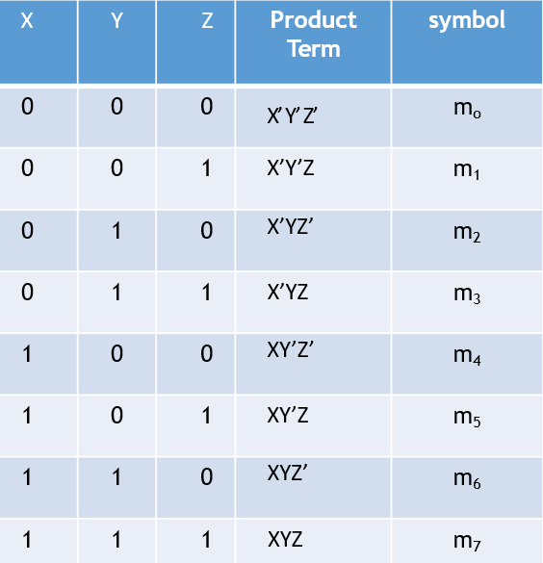
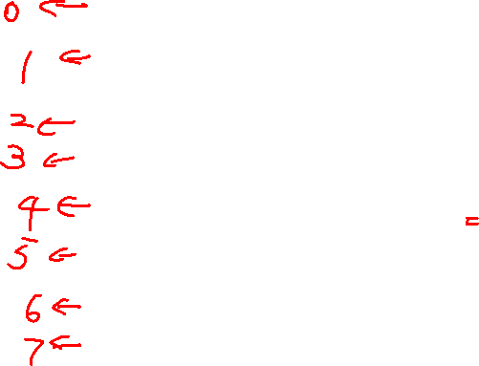
Minterm
A function with n variables has 2^{n} minterms. The literals are listed in the same order for all minterms (usually alphabetically)

Slide 8

Minterm
A variable in a minterm is complemented for 0 and is not complemented for 1

Slide 9
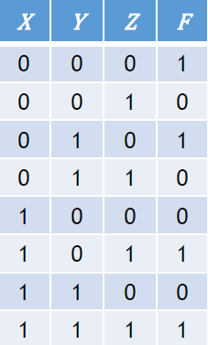
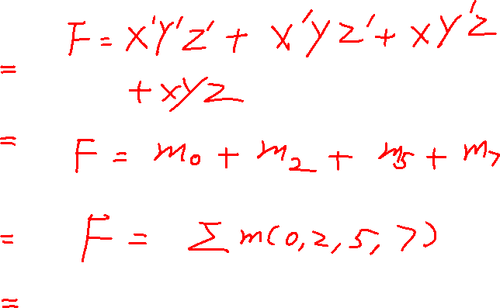
Sum of minterms canonical form
Function expressed as a logical sum (OR) of minterms
Sum of all minterms where the function value is 1

Slide 10
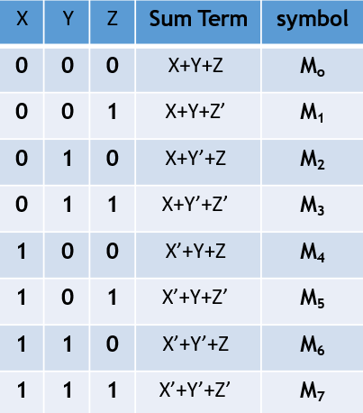

Maxterm
A function with n variables has 2^{n} maxterms. The literals are listed in the same order as for the maxterms with a corresponding maxterm

Slide 11

Maxterm
A variable in a maxterm is complemented for 1 and is not complemented for 0

Slide 12
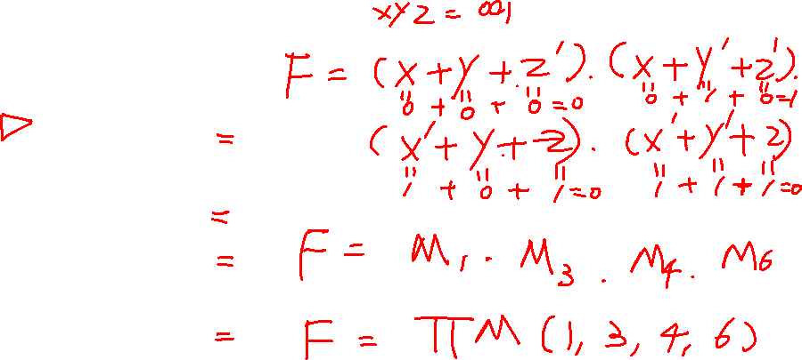
Product of maxterms canonical form
Function expressed as a logical product (AND) of maxterms
Product of all maxterms where the function value is 0

Slide 13
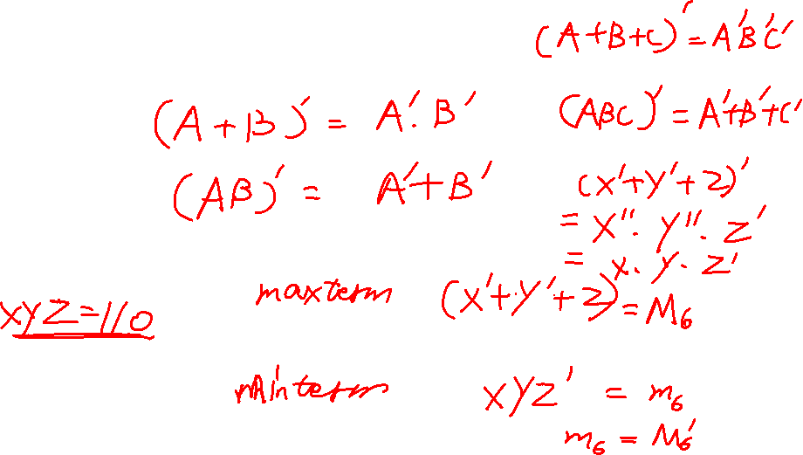
Minterms and maxterms relationship
DeMorgan’s Theorem
Two variable example:

Slide 14
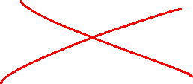
Function complements
The complement of a function expressed as a sum of minterms is constructed by selecting the minterms missing in the expression
Alternatively, the complement of a function expressed as a sum of minterms is simply the product of maxterms with the same indices

Slide 15
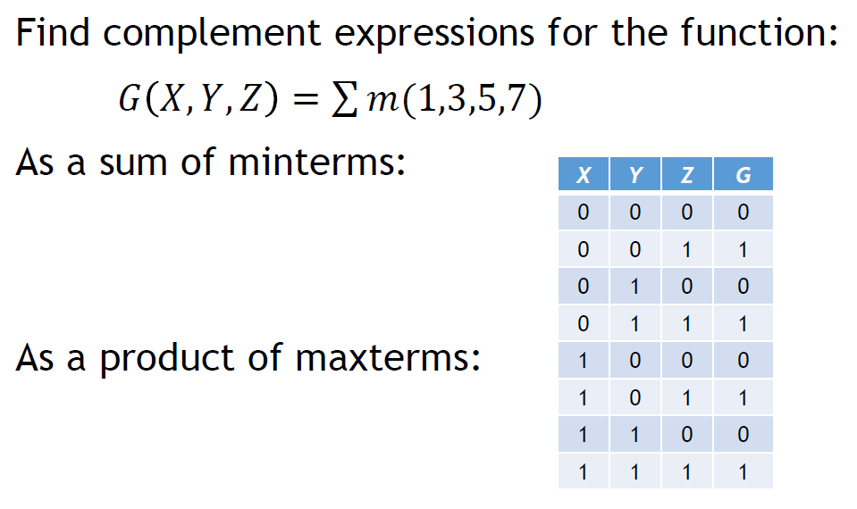
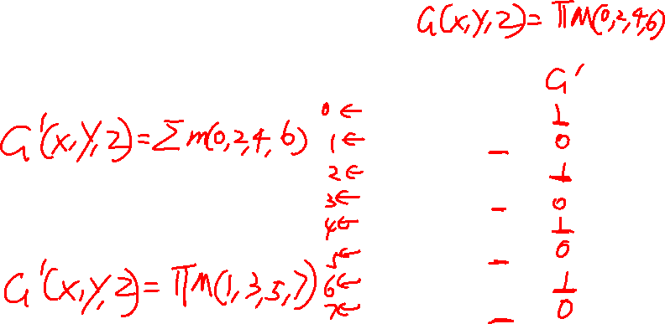
Function complement example

Slide 16
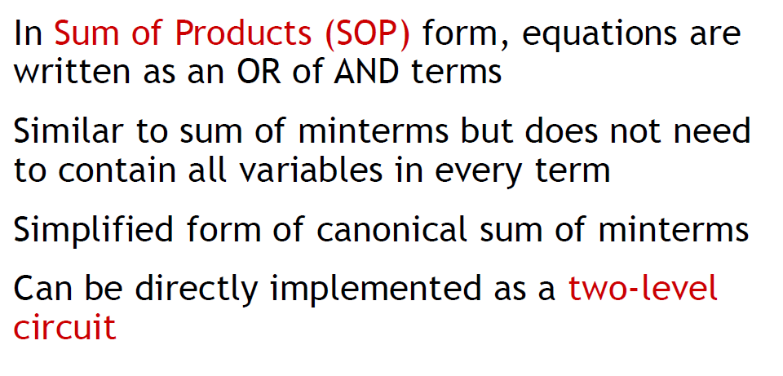
Sum-of-Products (SOP)

Slide 17
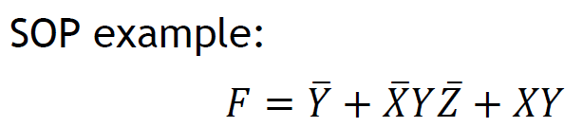
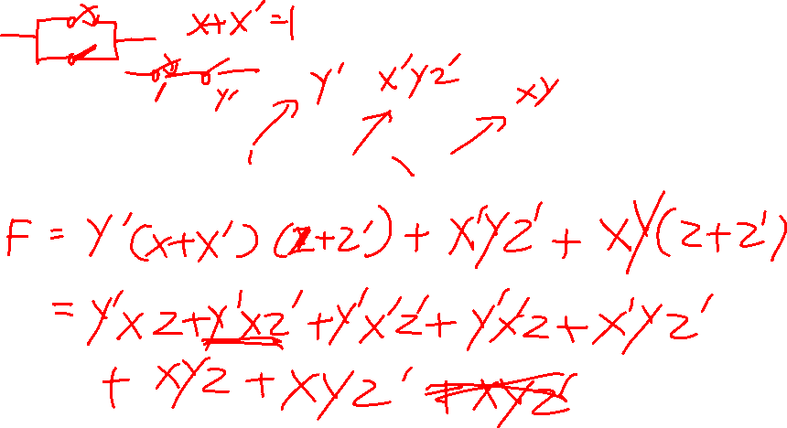
Sum-of-Products (SOP) example

Slide 18
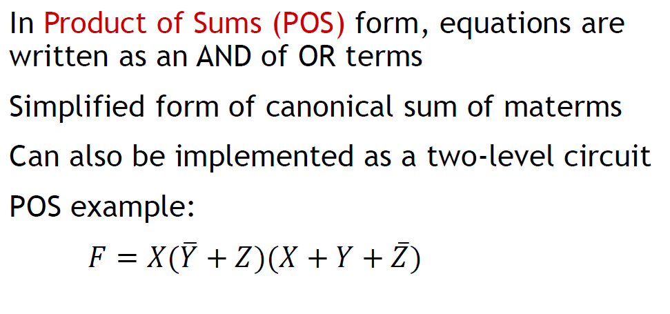
Product-of-Sums (POS)

Slide 19
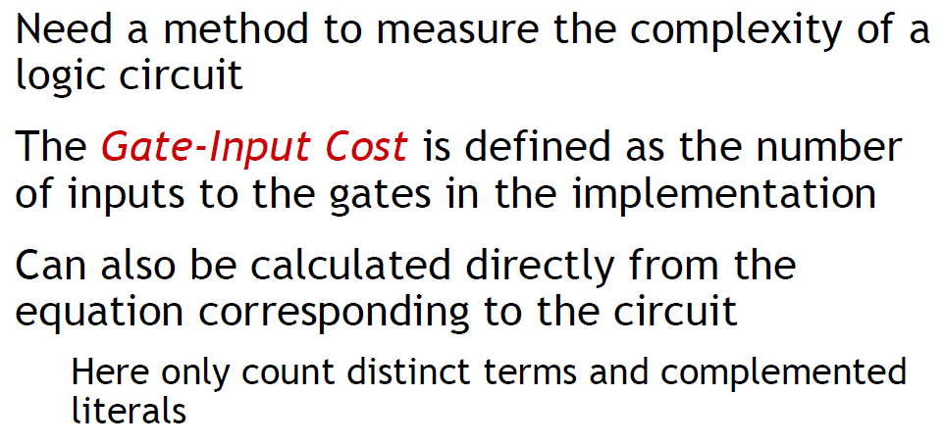
Cost criteria

Slide 20
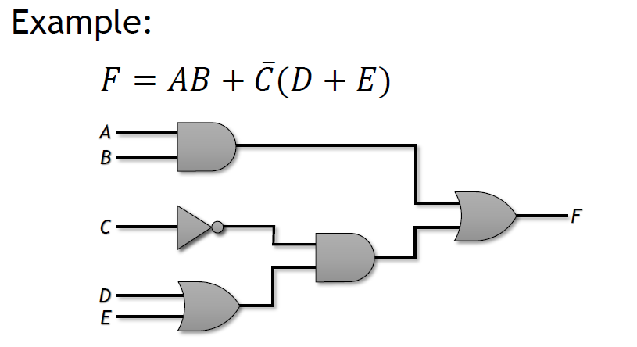
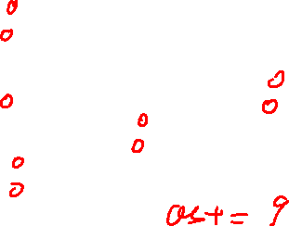
Input costs

Slide 21
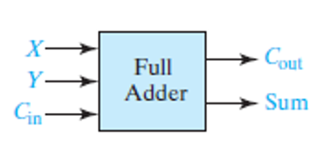
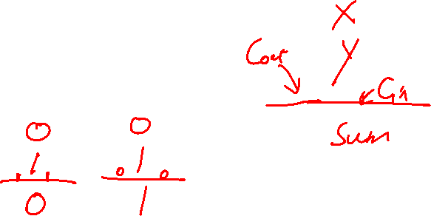
Design of Binary Adders and Subtracters
Full Adder Truth Table:

Slide 22
